Slide 1
Bottom half mechanisms

Slide 2
contents
Interrupts
Interrupt Service Routine
Why top halves and bottom halves ?
Raising an Interrupt (on x86 and arm)
Top halves
Bottom halves
Work queues (Static, Dynamic, Own)
Tasklets
Threaded irq
Soft irq
References

Slide 3
Interrupts
Interrupt signals are the distraction that divert the processor to a new activity outside of normal flow of execution
This new activity is called as interrupt handler. And the distraction is interrupt
What will happen when an interrupt is raised ?
Interrupt signals are directed to input pins on an interrupt controller (a simple chip that multiplexes multiple interrupt lines into a single line to the processor).
These are the process that will be done by kernel:
The interrupt controller sends a signal to the processor
The processor pauses its current execution to handle the interrupt
The processor notifies the OS that an interrupt has occurred and the OS can handle the interrupt appropriately

Slide 4
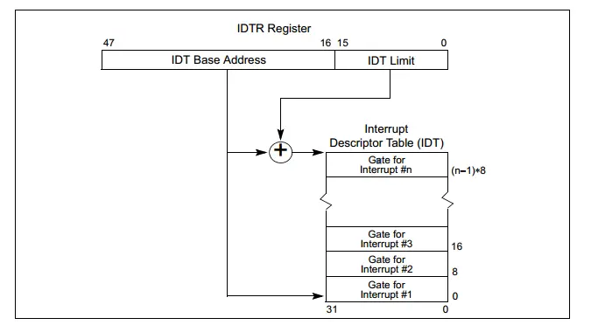
Intel or x86 processors handle interrupt using IDT (Interrupt Descriptor Table). The IDT consists of 256 entries (0 to 255) with each entry corresponding to a vector and of 8 bytes. All the entries are a pointer to the interrupt handling function. The CPU uses IDTR to point to IDT. The relation between those two can be depicted as below,

Slide 5
Interrupt service routine
When an interrupt is raised Interrupt Service Routine(ISR) is executed by the processor
An ISR (also called an interrupt handler) is a function that the kernel runs in response to a specific interrupt.
Each device that generates interrupts has an associated interrupt handler
The interrupt handler for a device is part of the device’s driver(the kernel code that manages the device).
In Linux, interrupt handlers are normal C functions, which match a specific prototype and thus enable the kernel to pass the handler information in standard way.

Slide 6
What differentiates interrupt handlers from other kernel functions is that the kernel invokes them in response to interrupts and they run in a special context called interrupt context.
To resume the normal flow of execution as soon as possible, it is important that:
To the hardware: the OS services the interrupt without delay.
To the rest of the system: the interrupt handler executes in as short a period as possible.
But the interrupt handlers can have a large amount of work to perform.

Slide 7
WHY TOP HALVES AND BOTTOM HALVES?
What if, we want to do a huge amount of work upon receiving interrupts? If we take more time to process, two things will happen:
While the highest priority ISR is running, it doesn’t let other interrupts to run.
Interrupts with the same type will be missed.
To eliminate that problem, the processing of interrupts is split into two parts:
Top halves
Bottom halves
Raising an interrupt is necessary to demonstrate bottom half mechanisms.

Slide 8
TRIGGERING HARDWARE INTERRUPT THROUGH SOFTWARE
An interrupt can be programmatically raised using ‘int’ instruction. For example, the Linux system call was using int $0x80. In Linux IRQ to vector, mapping is done in arch/x86/include/asm/irq_vectors.h.
A problem in New Linux kernel:
If you are using the newer Linux kernel, then this may not work properly. You may get something like below.
do_IRQ: 1.59 No irq handler for vector
For security purposes, they have removed this feature of raising a h/w interrupt through s/w

Slide 9
Hardware interrupt on arm
To overcome the previously mentioned problem, we have raised a hardware interrupt on ARM
We are using GPIO pins to invoke hardware interrupt. This is only possible on ARM development boards as they have built in GPIO pins.

Slide 10
Top half
The interrupt handler is the top half. The top half will run immediately upon receipt of the interrupt and performs only the work that is time-critical, such as acknowledging of the interrupt, resetting the hardware and scheduling the bottom halves.

Slide 11
Bottom halves
The bottom half is used to process data, letting the top half to deal with new incoming interrupts.
Interrupts are enabled when a bottom half runs. The interrupt can be disabled if necessary, but generally, this should be avoided as this goes against the basic purpose of having a bottom half – processing data while listening to new interrupts.
The bottom half runs in the future, at a more convenient time, with all interrupts enabled.

Slide 12
Types of bottom halves
There are 4 bottom half mechanisms
Workqueue
Threaded IRQs
Softirq
Tasklets

Slide 13
1.WORKQUEUES

Slide 14
Introduction to Workqueue
Work queues are a form of deferring work. Work queues defer work into a kernel thread, this bottom half always runs in the process context.
This will run in the process context and the work queue can sleep.
Code deferred to a work queue has all the usual benefits of process context.
Most importantly, work queues are schedulable and can therefore sleep.

Slide 15
Ways to implement workqueues:
Using global workqueue.
Static workqueue.
Dynamic workqueue.
Creating Own workqueue.

Slide 16
Global Workqueue AND Global Worker Thread
Kernel maintains a global linked list where it contains all the works. Each work is completed one after the other and moved out of the queue once done.
Worker threads, are dedicated threads that execute and pull the functions off the queue, one by one, one after the other.

Slide 17
Steps for static workqueue
Initialize a work using the following macro:
DECLARE_WORK(name, void (*func) (void * ) )
name - The name of the work_struct structure that has to be created.
func - The function to be scheduled in the workqueue
Schedule the work using following function:
int schedule_work(struct work_struct *work);
work – job to be done
This function puts a job in the kernel-global workqueue if it was not already queued
Returns zero if work is already on the global workqueue and non-zero otherwise

Slide 18
Schedule delayed work
Initialize a delayed work using the following macro:
DECLARE_DELAYED_WORK(name, void (*func) (void * ) )
name - The name of the work_struct structure that has to be created.
func - The function to be scheduled in the workqueue
Schedule the work using following function:
int schedule_delayed_work(struct delayed_work *dwork, unsigned long delay);
dwork – job to be done
delay – delay in terms of jiffies
This function puts a job in the kernel-global workqueue if it was not already queued
Returns zero if work is already on the global workqueue and non-zero otherwise

Slide 19
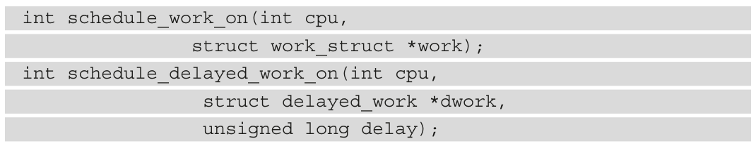
We can schedule a work or delayed work on a specific CPU by using ‘ _on ‘ variants on the same functions.

Slide 20
In order to flush the kernel-global workqueue – that is, ensure a given batch of work is completed – we can use flush_scheduled_work(), as follows:
void flush_scheduled_work(void);
There may be works in the system_wq workqueue that you have no control over. So this is unnecessary.
It is recommended to run following function instead:
int cancel_work_sync(struct work_struct *work);
You can cancel work if it is not already executing in a handler. This function will terminate the work in the queue or block until the work has finished.

Slide 21
Check the workqueue
We can find out whether a work item is pending or not with this call:
work_pending(work);
delayed_work_pending(dwork);

Slide 22
Dynamic initialization
For dynamic declaration of workqueue we can use following macros
INIT_WORK(work, func) /*declare this variable : static struct work_struct workqueue, where as in static method, this is not necessary*/
INIT_DELAYED_WORK(work, func)
Rest all other functions remain same as in case of static.

Slide 23
OWN WORKQUEUE
Create and destroy workqueue structure
Workqueues are created through a function called create_workqueue, which returns a workqueue_struct reference. You can remove this workqueue later (if needed) through a call to the destroy_workqueue function
struct workqueue_struct *create_workqueue( name ); //”wq”
With the work structure initialized, we have to queue the work on the CPU with following function:
queue_work(struct workqueue_struct *wq, struct work_struct *work);
This function needs to be included in top half

Slide 24
2.TASKLETS

Slide 25
INTRODUCTION TO TASKLETS
Tasklets are used to queue up work to be done at a later time. Tasklets can be run in parallel, but the same tasklet cannot be run on multiple CPUs at same time.
Each tasklet will run only on the CPU that schedules it, to optimize cache usage.
Tasklets cannot sleep but workqueues can, tasklets run in interrupt context and workqueues run in process context.

Slide 26
Tasklet STATIc method
Initialization of tasklet structure:
DECLARE_TASKLET(name , func)
This macro used to create the tasklet structure and assigns the parameters to that structure.
If we are using this macro then the tasklet will be in the enabled state.
name – name of the structure to be created
func – this is the main function of the tasklet. Pointer to the function that needs to schedule for execution at a later time.

Slide 27
Disabled tasklet
The tasklet can be declared and set at a disabled state, which means that the tasklet can be scheduled, but will not run until the tasklet is specifically enabled. You need to use tasklet_enable to enable
DECLARE_TASKLET_DISABLED(name, func);
name – name of the structure to be created
func – this is the main function of the tasklet. Pointer to the function that needs to schedule for execution at a later time.

Slide 28
Schedule the tasklet
When we schedule the tasklet, then that tasklet is placed into one queue out of two, depending on the priority. Queues are organized as singly-linked lists. At that, each CPU has its own queues
There are two priorities
Normal Priority
High Priority
tasklet_schedule()
Schedule a tasklet with a normal priority. If a tasklet has previously been scheduled, the new scheduled will be silently discared.

Slide 29
void tasklet_schedule(struct tasklet_struct *t);
t - pointer to the tasklet struct
tasklet_hi_schedule
Schedule a tasklet with high priority. If a tasklet has previously been scheduled (but not yet run), the new schedule will be silently discarded.
void tasklet_hi_schedule(struct tasklet_struct * t);
t- pointer to the tasklet struct

Slide 30
Enable and disable tasklet
tasklet_enable
This is used to enable the tasklet
void tasklet_enable(struct);
tasklet_disable()
This is used to disable the tasklet waits for the tasklet’s completion.
void tasklet_disable(struct tasklet_struct *t);
t – pointer to the tasklet struct

Slide 31
KILL TASKLET
Finally after a tasklet has been created, it’s possible to delete a tasklet through these below functions
tasklet_kill()
This will wait for its completion and then kill it
void tasklet_kill(struct tasklet_struct * t);
t-pointer to tasklet struct
tasklet_kill_immediate
This is used only when a given CPU is in the dead state
void tasklet_kill_immediate(struct tasklet_struct *t, unsigned int cpu);

Slide 32
3.Threaded Irq

Slide 33
Introduction to Threaded irq
The main aim of the threaded IRQ is to reduce the time spent with interrupts being disabled to a bare minimum and that will increase the chances of handling other interrupts.
With threaded IRQ the way we are registering an interrupt handler is a bit simplified, the core schedules the bottom half for us and the bottom half is executed in a dedicated kernel thread.
We do not use request_irq() instead we use request_threaded_irq()

Slide 34
To eliminate delay, we do just do a very important process in the interrupt handler function and defer other stuff to thread function.
In this case interrupts have not been disabled for more time.

Slide 35
Threaded irq functions
We have to use the request_threaded_irq and pass two handlers to this function.
int request_threaded_irq(unsigned int irq,
irq_handler_t handler,
irq_handler_t thread_fun,
unsigned long irqflags,
const char *devname,
void *dev_id
);

Slide 36
Where,
irq : irq line number
handler: Primary handler for threaded interrupts. The function will be invoked whenever the operating system receives the interrupt. The data type of return is irq_handler_t, if its return
Value is IRQ_HANDLED, it indicates that the processing is completed successfully, but if the return value is IRQ_NONE, the processing fails. If it returns IRQ_WAKE_THREAD, then the kernel calls thread function.
If this handler is NULL and thread function is not NULL the default primary handler is used

Slide 37
Thread_fn:
A fucnction called from the irq handler. If NULL, no IRQ thread is created. This represents the bottom half. When the handler function return IRQ_WAKE_THREAD the kthread associated with this bottom half will be scheduled and thread_fn will be called.
The thread function must return IRQ_HANDLED
irqflags:
IRQF_DISABLED, IRQF_SAMPLE_RANDOM, IRQF_SHARED, IRQF_TIMER, IRQF_TRIGGER_RISING etc.

Slide 38
devname:
Used to identify the device name using this IRQ, for example, cat /proc/interrupts will list the IRQ number and device name.
dev_id:
unique cookie to enable the removal of only the desired interrupt handler from the interrupt line.

Slide 39
4.Soft irq

Slide 40
Introduction to soft irq
Softirq is also known as a software interrupt request. When we have more work do to in the ISR, we can defer some work to later. So, we do the necessary work in the original ISR (top half) and trigger the softirq. The softirq is rarely used as we have tasklets already. Most of the stuff, we can do using the tasklets. Do you know one thing? Tasklets also built on softirq.

Slide 41

We need to make changes to the kernel source code to enable SOFTIRQs
Why do we need to make changes in the Linux Kernel?
Unlike tasklets, Softirqs are statically allocated at the compile time. So we cannot dynamically create or kill the softirqs. Softirqs are represented using the struct softirq_action which is defined in <linux/interrupt.h>.

Slide 42
Kernel code changes
As we have told you already, we have to make changes in the Linux kernel source code to implement this softirq. These are the below changes that we have to make in the Linux kernel source code.
Add element EMBETRONICX_SOFT_IRQ in the enum in <linux/interrupt.h>
Export these APIs ( raise_softirq, raise_softirq_irqoff, open_softirq)

Slide 43
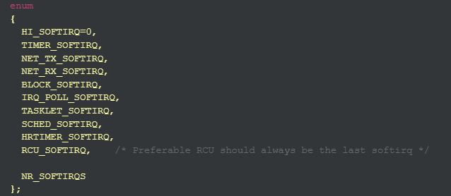
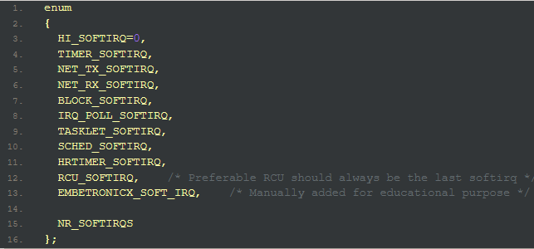
Softirq Enum

Slide 44
Create the Softirq
We have to create our own callback function to do our operations in the bottom half. When the kernel runs a softirq handler, it executes this callback function. The callback function should be created like this prototype.
void softirq_handler(struct softirq_action *);

Slide 45
Register the softirq with the handler
Till now, we have created the softirq entry and the softirq handler. Now, we have to register the softirq entry with the softirq handler. To do that, use the below API.
void open_softirq( int nr, void (*action)(struct softirq_action *) );
Where,
nr – Softirq entry. In our case, it should be EMBETRONICX_SOFT_IRQ .
action– Softirq handler

Slide 46
Trigger the softirq
We are all set. When we want to call our softirq handler, we have to trigger( raise) the softirq from the ISR. The below API is used to trigger the softirq.
void raise_softirq(unsigned int nr);
Where,
nr – Softirq entry. In our case, it should be EMBETRONICX_SOFT_IRQ

Slide 47
DISCLAIMER
These functions are not exported by default
We have to make these changes in kernel and recompile the kernel again so that we can use the softirq which we have created, as we are using kernel source code from buildroot this may lead to breaking of some functionalities.
Now, you are probably wondering why those functions aren’t exported, because softirqs are a low-level mechanism, meant to be used by other higher-level facilities, so the intention is to prevent its usage in non-core kernel code.

Slide 48
References
EmbeTronicx Website
Linux Device Driver Development – John Madieu

